Slide 1
Comparing PROBE clashscore to Restraints Manager non-bonded clashscore

Slide 2
Motivation
Develop a PROBE like clash score, faster and integrated into the refinement process.

Slide 3
Chemical properties and other issues
PROBE ignores clashes that are due to symmetry operation
VDW radius of oxygen used by PROBE is smaller (1.4A) compare to the one used in restraints manager (1.52A)
References:
Li and Nussinov, Proteins, 32 111-127 (1998) A set of van der Waals and Coulombic radii of protein atoms for molecular and solvent-accessible surface calculation, packing evaluation, and docking
Intermolecular nonbonded contact distances in organic crystal structures: Comparison with distances expected from van der Waals radii
Gavezzotti, J. Am. Chem. Soc. (1983) 105, 5220-5225.
Bondi, J. Phys. Chem. (1964), V68, N3, 441-451. , van der Waals Volumes and Radii

Slide 4
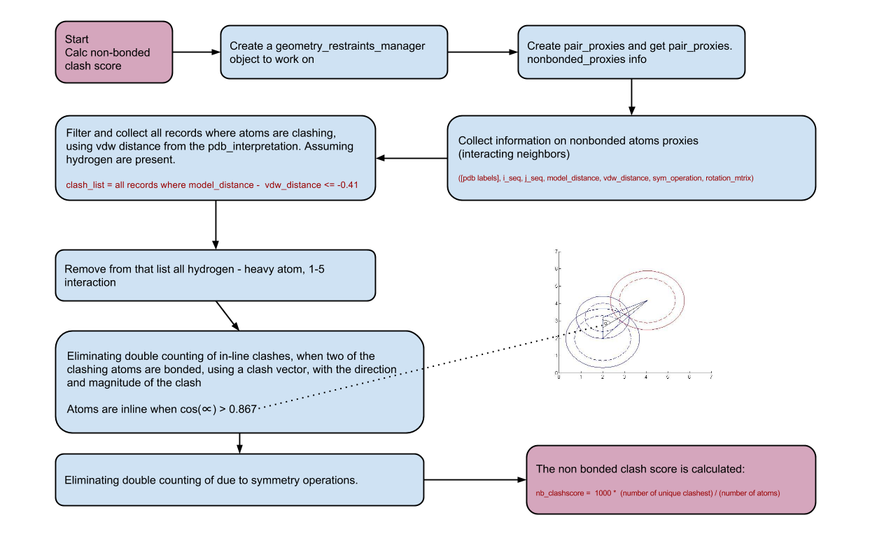
Restraints Manager non-bonded clashscore

Slide 5
Scoring Differences
The number of files with abs(clashscore - nb_clashscore) > 10:
NEUTRON DIFFRACTION has 3 out of 66 NMR has 608 out of 10162 X-RAY DIFFRACTION has 5016 out of 83757 SMALL ANGLE X-RAY SCATTERING has 4 out of 46 Other has 0 out of 24 ELECTRON MICROSCOPE has 56 out of 688
The number of files with abs(clashscore - without_sym_nb_clashscore) > 10:
NEUTRON DIFFRACTION has 5 out of 66 NMR has 608 out of 10162 X-RAY DIFFRACTION has 2097 out of 83757 SMALL ANGLE X-RAY SCATTERING has 4 out of 46 Other has 0 out of 24 ELECTRON MICROSCOPE has 51 out of 688

Slide 6
Difference
The number of files with abs(clashscore - nb_clashscore)/(clashscore + 0.001) > 0.3:
NEUTRON DIFFRACTION has 19 out of 66 NMR has 2652 out of 10162 X-RAY DIFFRACTION has 23344 out of 83757 SMALL ANGLE X-RAY SCATTERING has 13 out of 46 Other has 0 out of 24 ELECTRON MICROSCOPE has 199 out of 688
The number of files with abs(total_nb_clashscore - without_sym_nb_clashscore) > 10:
NEUTRON DIFFRACTION has 1 out of 66 NMR has 0 out of 10162 X-RAY DIFFRACTION has 1277 out of 83757 SMALL ANGLE X-RAY SCATTERING has 0 out of 46 Other has 0 out of 24 ELECTRON MICROSCOPE has 6 out of 688

Slide 7
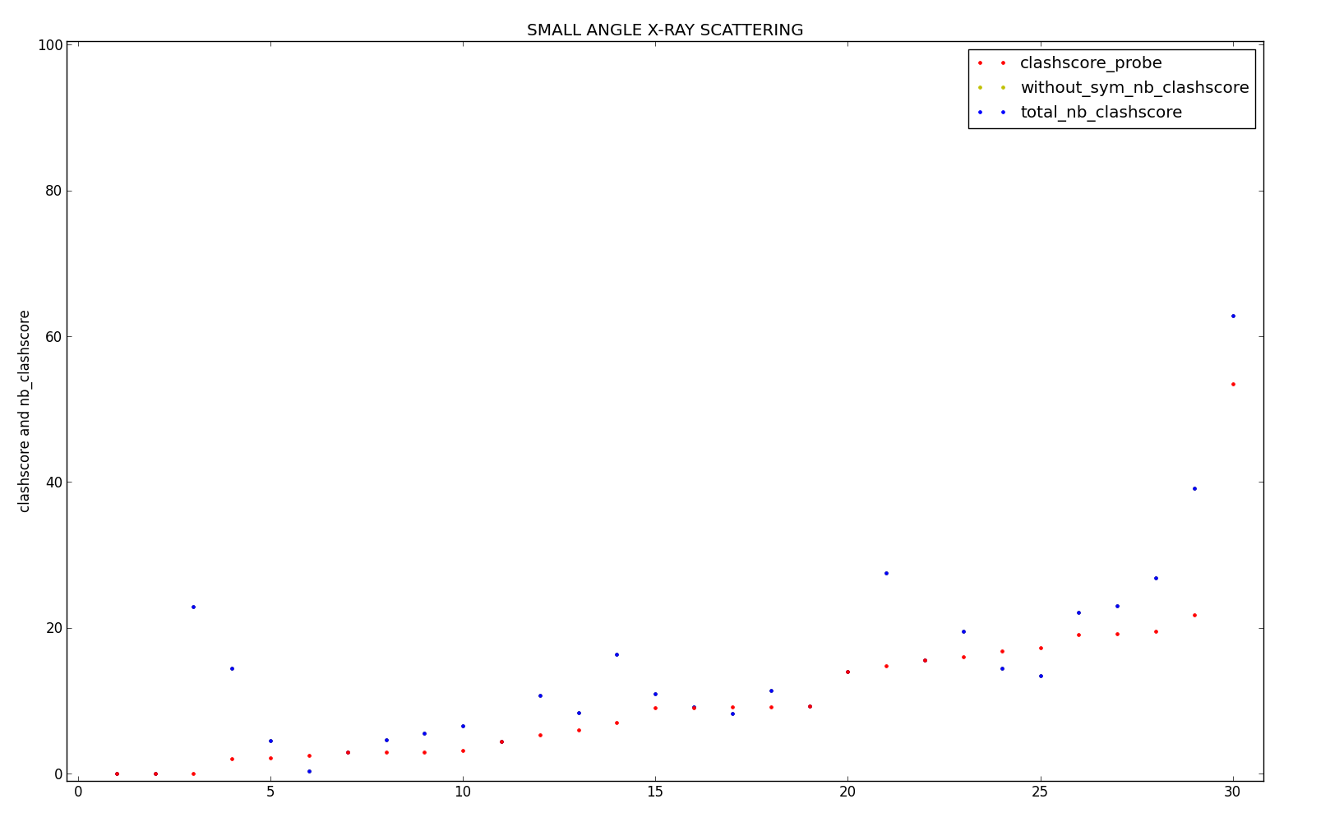
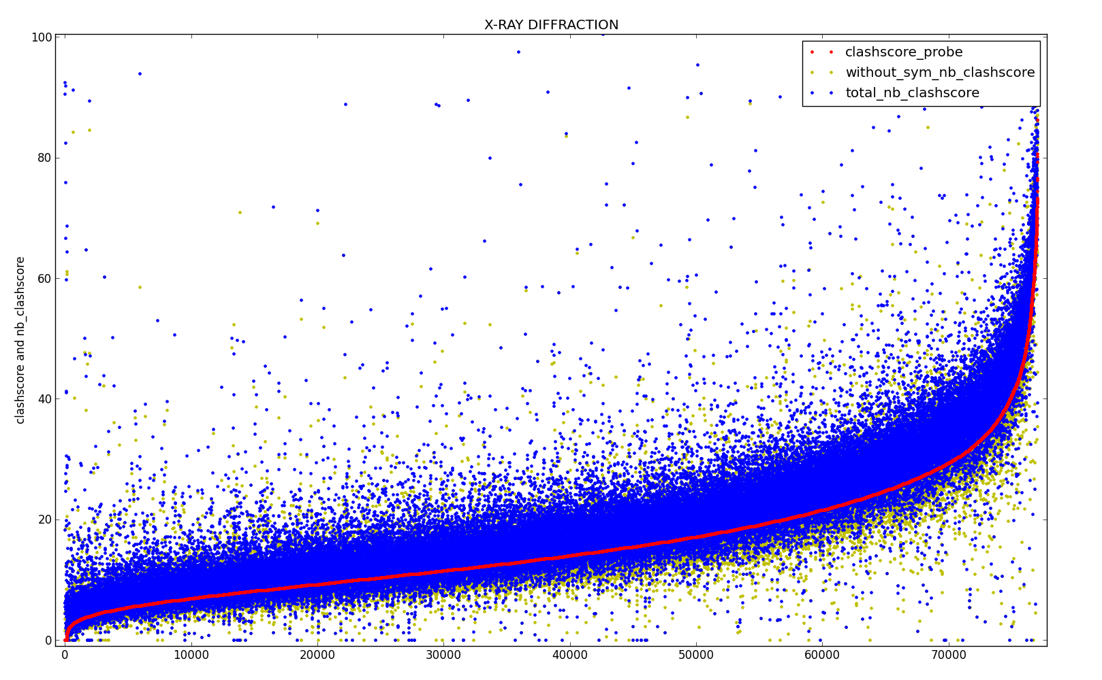
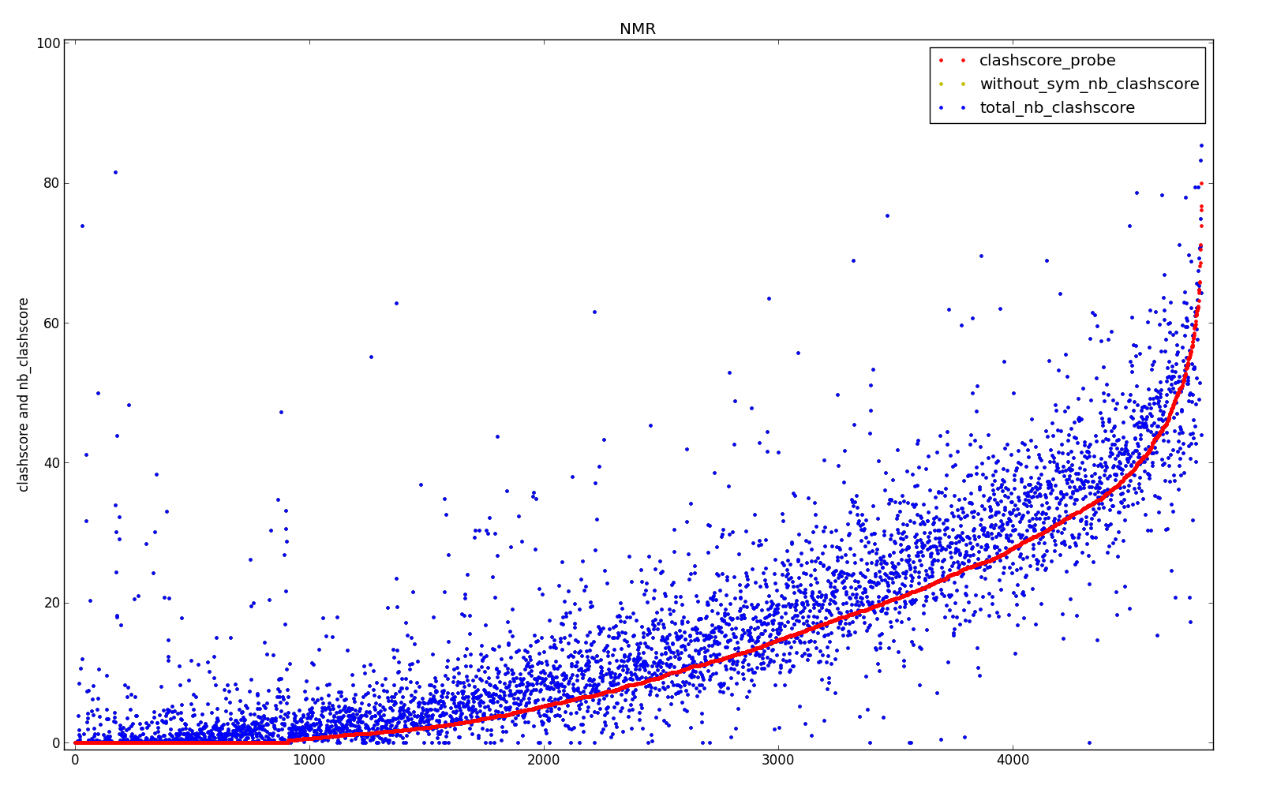
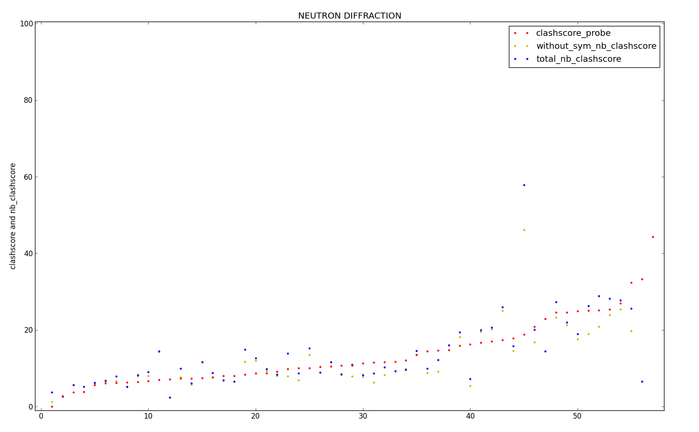

Slide 8
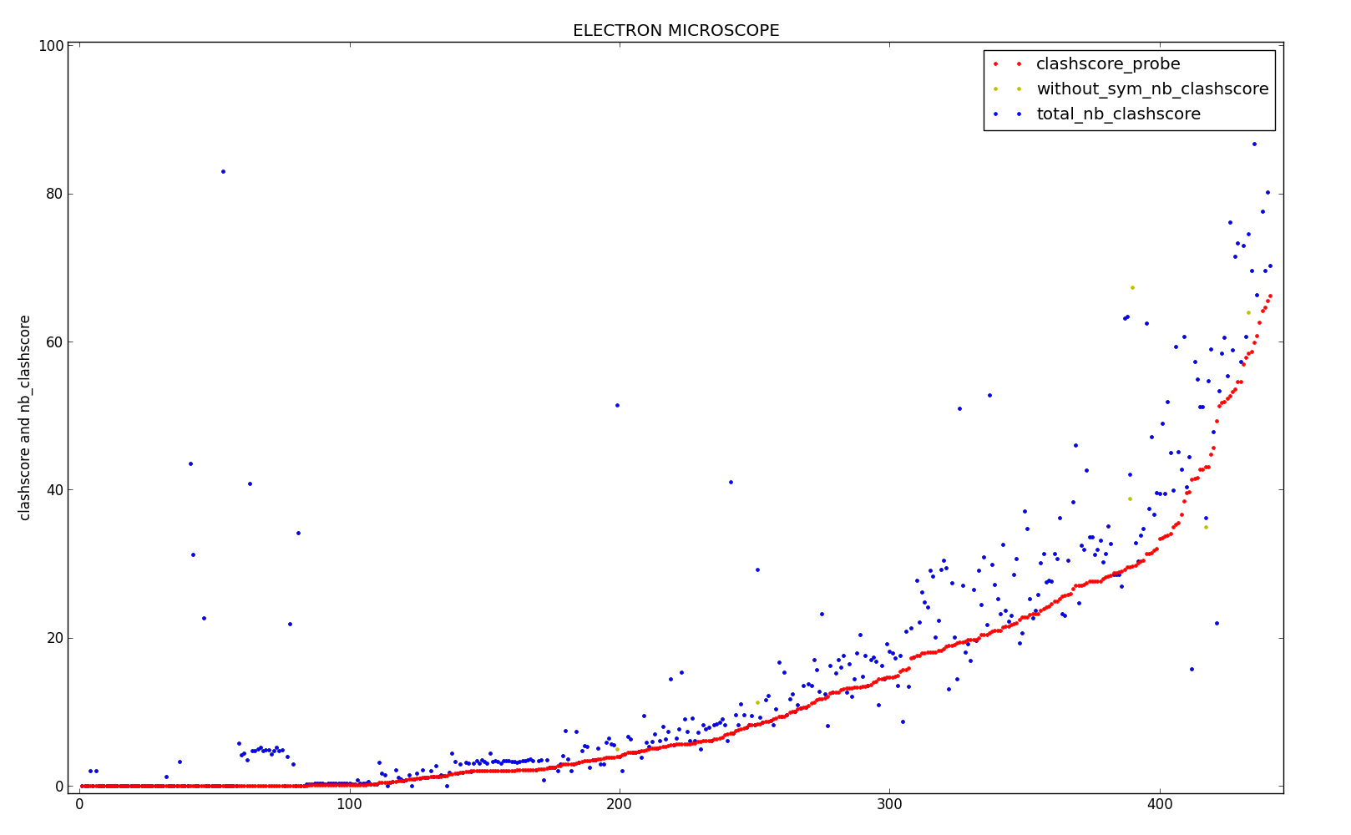
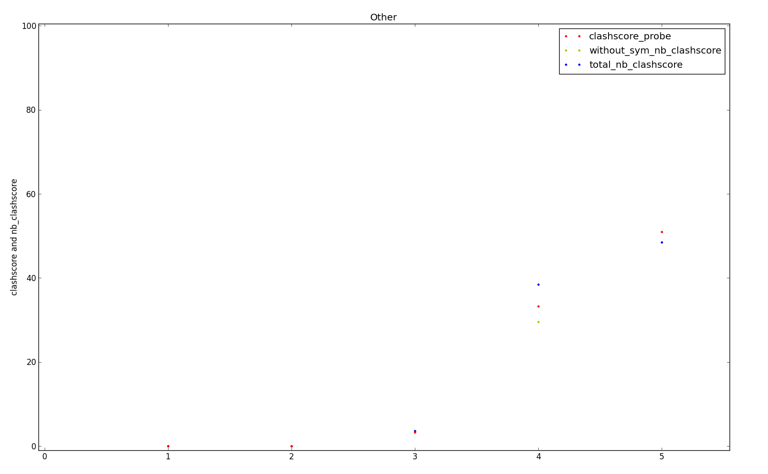

Slide 9
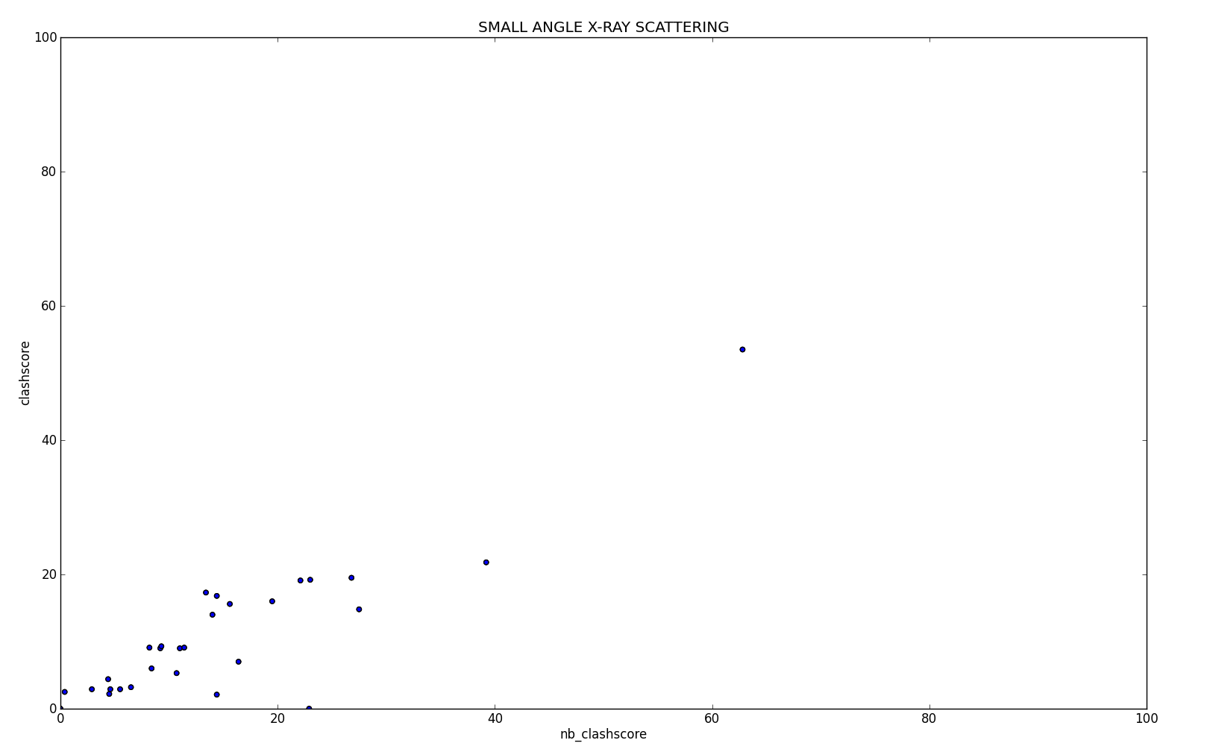
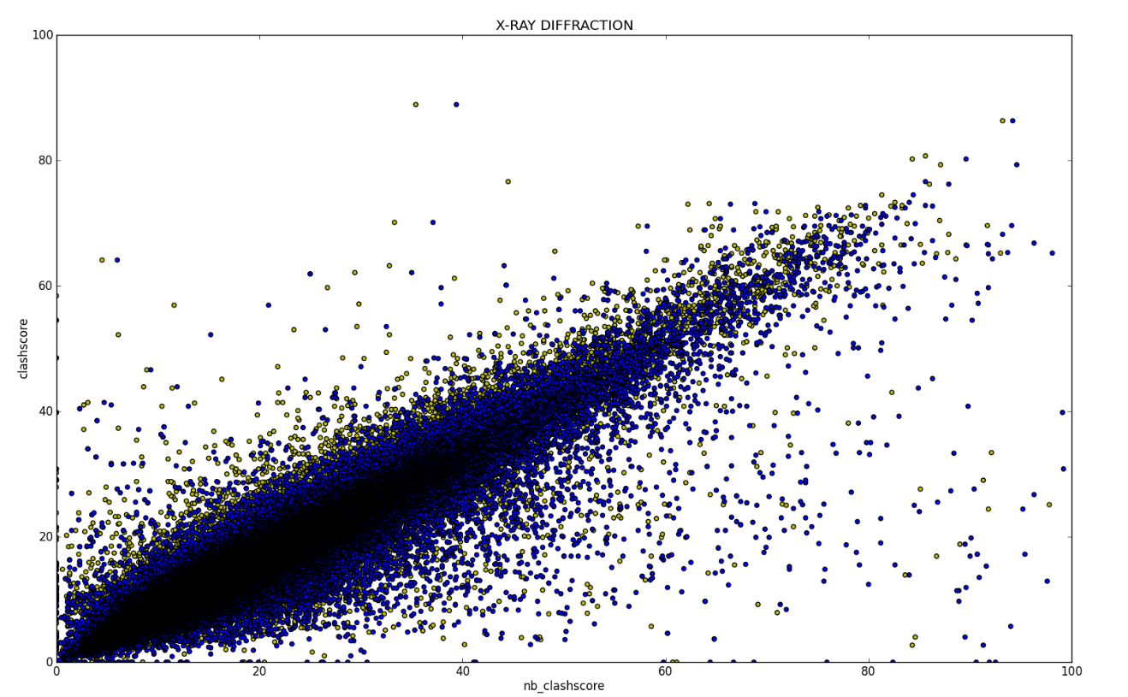
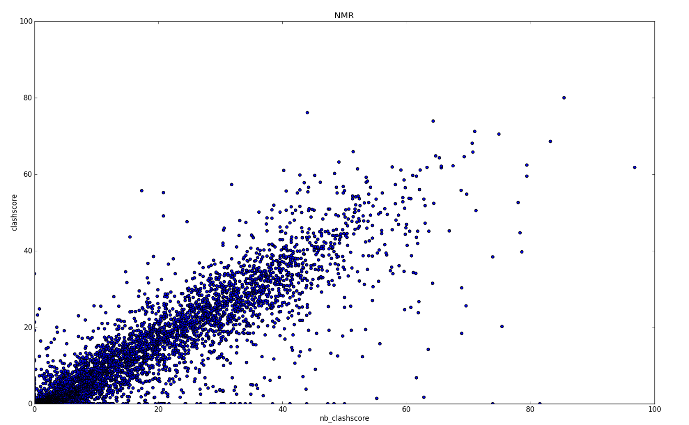
2zij

Slide 10
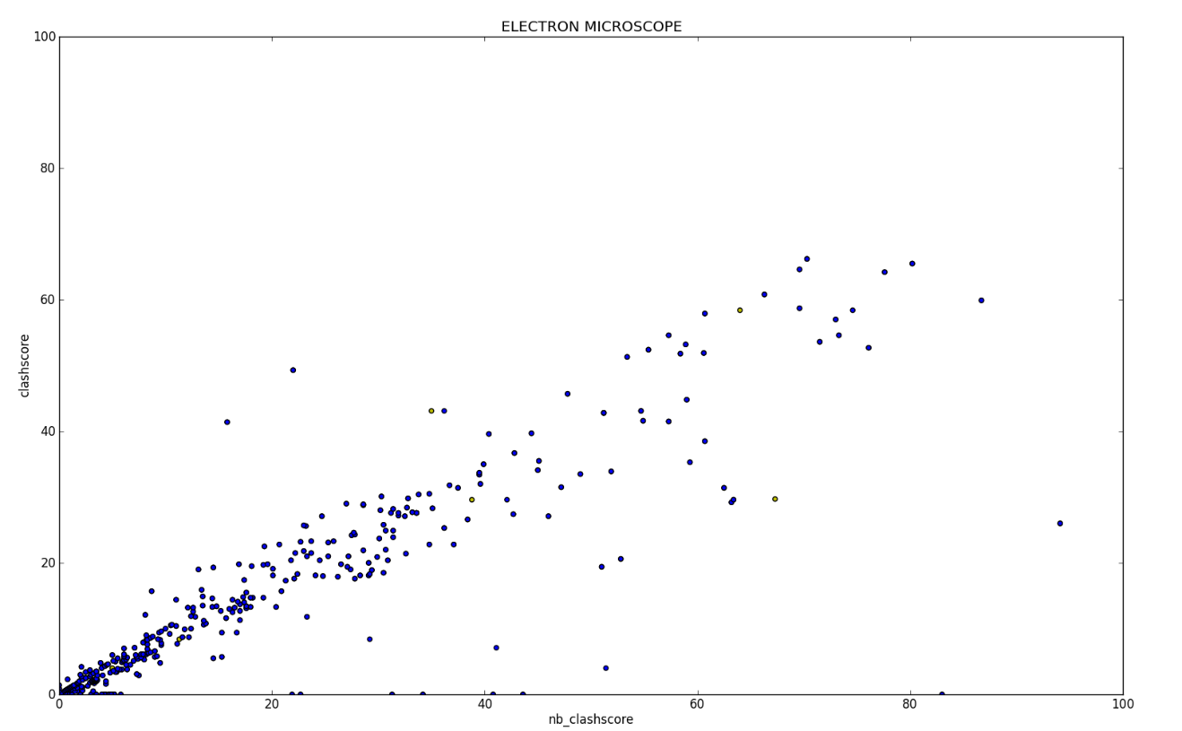
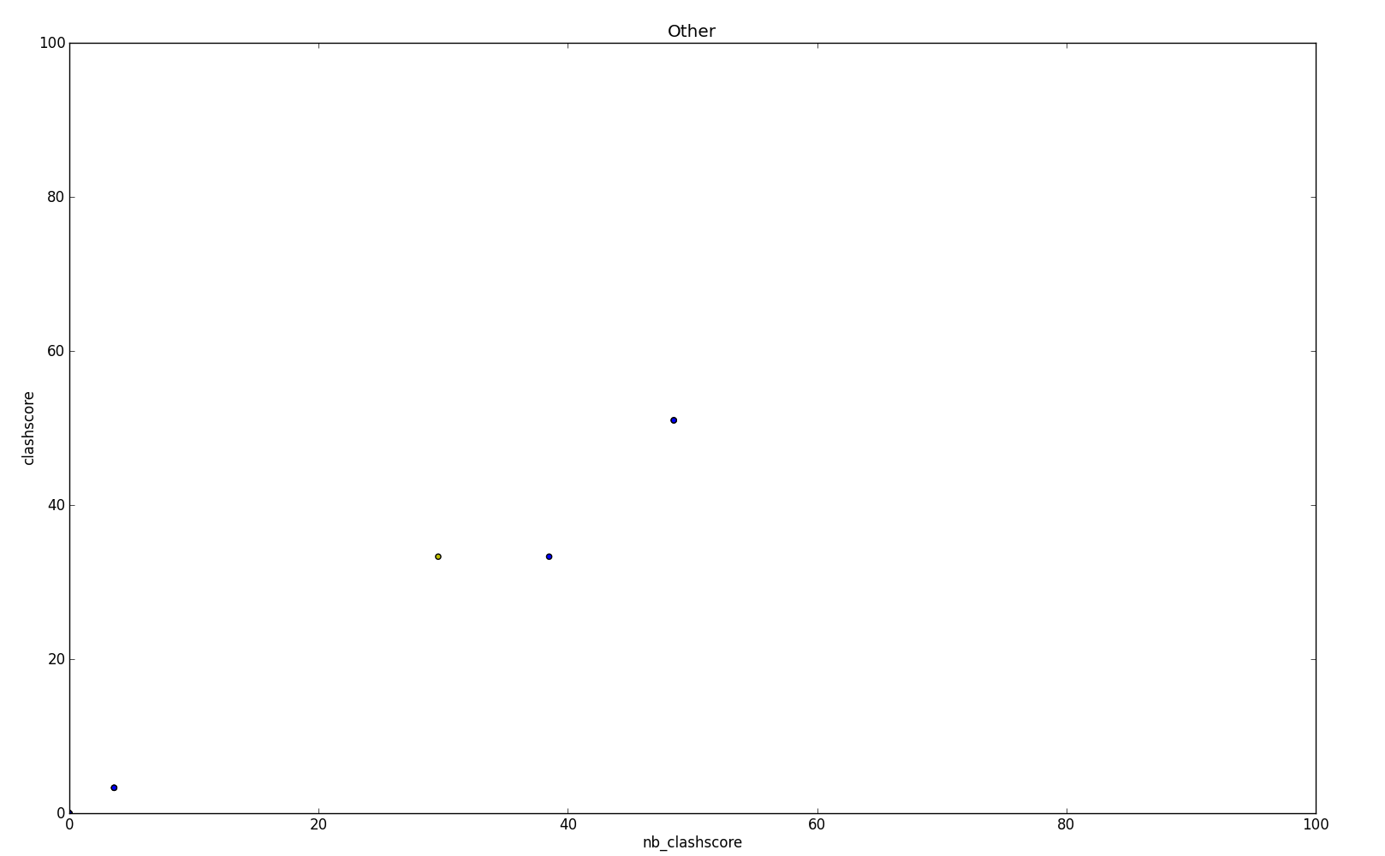

Slide 11



List of interesting points – XRAY Diffraction
The data below represents:
pdb_file [nb_score including symmetry, nb_score including symmetry,PROBE clashscore]
$$∆<−30$$
$$∆>30$$
$$∆>60$$
1c4s [994.6, 0.0, 58.4]
1d7z [0.0, 0.0, 54.5]
1iha [6.0, 4.5, 64.1]
2fil [39.4, 35.4, 88.9]
2elg [22.8, 11.4, 43.7]
1d9r [13.0, 10.4, 40.8]
2h0n [0.0, 0.0, 30.8]
2gpm [3.1, 3.1, 34.0]
2gq6 [4.0, 4.0, 38.5]
2g32 [2.3, 2.3, 40.4]
3ok2 [9.3, 8.9, 46.6]
452d [25.0, 25.0, 61.9]
2gq7 [4.7, 3.1, 41.4]
1xj9 [0.0, 0.0, 39.8]
1p54 [35.0, 29.4, 62.1]
1bq8 [42.2, 36.1, 5.0]
1hya [6837.7, 181.8, 0.0]
1v4f [137.3, 45.8, 3.9]
1v6q [119.0, 47.6, 4.0]
1v7h [143.8, 52.3, 7.8]
1vtr [136.1, 71.0, 7.9]
1wzb [91.3, 84.3, 2.7]
2hya [11619.0, 201.1, 21.2]
5fx2 [64.4, 60.7, 0.0]
1m24 [43.8, 38.1, 3.8]
1ym8 [89.5, 84.6, 4.0]
1rwj [40.7, 38.7, 8.2]
3pod [50.3, 40.4, 8.7]
1xvr [58.5, 58.5, 15.2]
1a7z [55.0, 51.9, 9.4]
3cyr [46.7, 40.2, 2.8]
1hya [6837.7, 181.8, 0.0]
1vtr [136.1, 71.0, 7.9]
1wzb [91.3, 84.3, 2.7]
2hya [11619.0, 201.1, 21.2]
5fx2 [64.4, 60.7, 0.0]
1ym8 [89.5, 84.6, 4.0]
1c58 [345.1, 325.2, 6.9]
1a7y [115.2, 110.4, 11.2]
3njw [64.8, 64.8, 3.7]
2d94 [147.5, 106.2, 31.9]
4k7t [68.7, 61.1, 0.0]
1w7q [95.2, 91.8, 24.4]
1qfi [112.9, 105.0, 21.9]
3thk [188.1, 188.1, 9.0]
3p4j [149.5, 115.1, 20.4]
1mou [90.0, 86.7, 16.9]

Slide 12
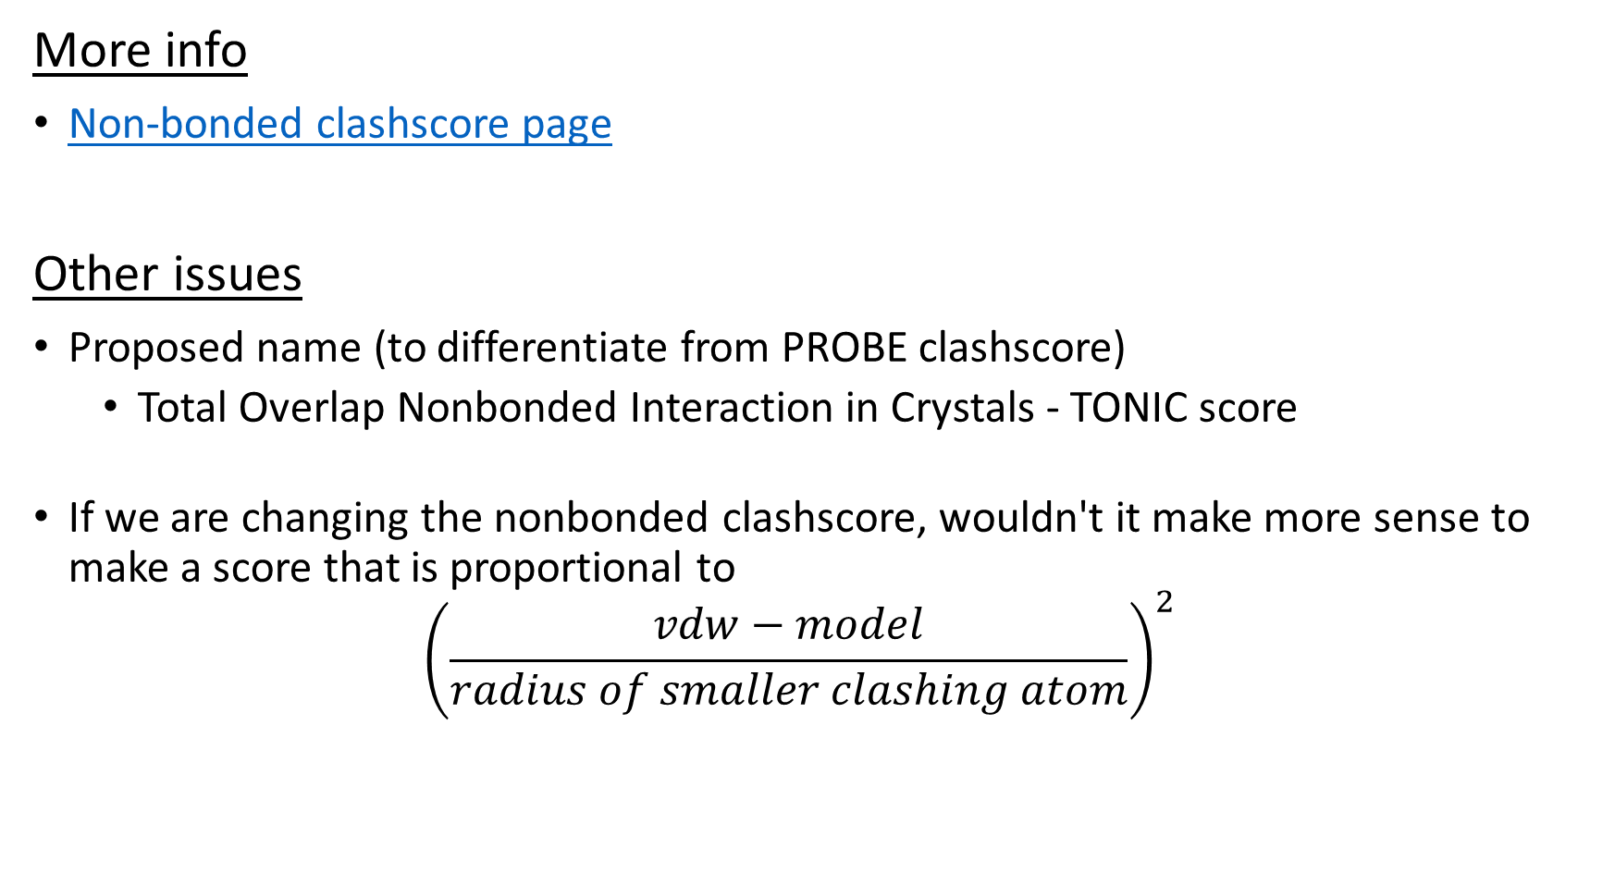
More info
Non-bonded clashscore page
Other issues
Proposed name (to differentiate from PROBE clashscore)
Total Overlap Nonbonded Interaction in Crystals - TONIC score
If we are changing the nonbonded clashscore, wouldn't it make more sense to make a score that is proportional to ${\left(\frac{vdw−model}{radius of smaller clashing atom}\right)}^{2}$

